Slide 1


Traffic Matrix Prediction based on Bidirectional Recurrent Neural Network and Long Short-Term Memory
Van An Le † Phi Le Nguyen† Yusheng Ji†‡
† Department of Informatics, SOKENDAI (The Graduate University for Advanced Studies)
‡National Institute of Informatics, Tokyo, Japan

Slide 2
AGENDA
Introduction
Related works
Problem description and goal
Proposed approach
Evaluation
Conclusion and future work

Slide 3
AGENDA
Introduction
Related works
Problem description and goal
Proposed approach
Evaluation
Conclusion and future work

Slide 4
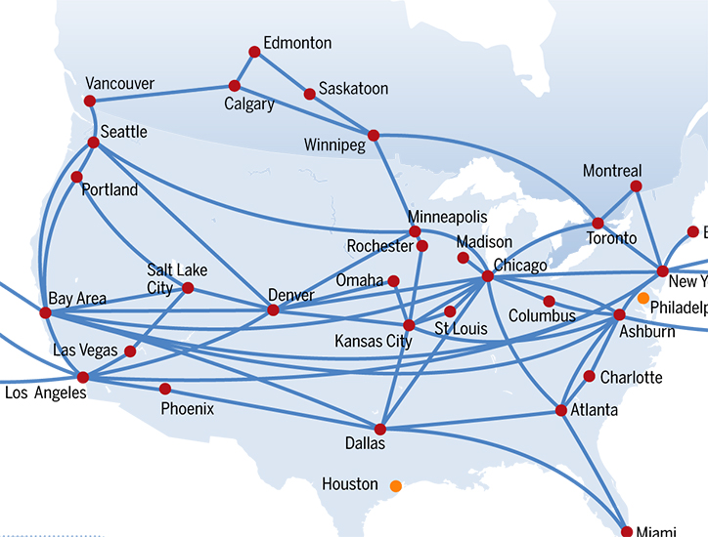
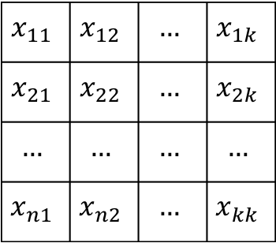
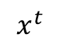

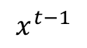
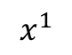
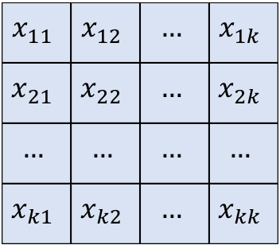
Introduction
TRAFFIC MATRIX: an abstract representation of the traffic volume flowing between set of sources and destinations pairs.
$$x^{1}$$
$$x_{11}$$ | $$x_{12}$$ | $$…$$ | $$x_{1k}$$
$$x_{21}$$ | $$x_{22}$$ | $$…$$ | $$x_{2k}$$
$$…$$ | $$…$$ | $$…$$ | $$…$$
$$x_{n1}$$ | $$x_{n2}$$ | $$…$$ | $$x_{kk}$$
$$x^{t−1}$$
$$x_{11}$$ | $$x_{12}$$ | $$…$$ | $$x_{1k}$$
$$x_{21}$$ | $$x_{22}$$ | $$…$$ | $$x_{2k}$$
$$…$$ | $$…$$ | $$…$$ | $$…$$
$$x_{n1}$$ | $$x_{n2}$$ | $$…$$ | $$x_{kk}$$
$$x^{t}$$
$$x_{11}$$ | $$x_{12}$$ | $$…$$ | $$x_{1k}$$
$$x_{21}$$ | $$x_{22}$$ | $$…$$ | $$x_{2k}$$
$$…$$ | $$…$$ | $$…$$ | $$…$$
$$x_{k1}$$ | $$x_{k2}$$ | $$…$$ | $$x_{kk}$$

Slide 5
Introduction
Traffic Matrix
Network Optimization
Anomaly Detection
Protocol Design
...
QoS provisioning

Slide 6
Related works
 | Network tomography based approach
 | Traffic interpolation using Compressive Sensing and Matrix Completion
 | Traffic prediction using Deep Learning approach
Network tomography:
Estimating traffic from link data.
Infocom
SDN-based traffic aggregation and measurement paradigm.
1996
2009
2014
2015
Sigcomm:
Spatial-temporal Compressive sensing approach.
Infocom
Adaptive sampling for traffic completion.

Slide 7
Related works
 | Network tomography based approach
 | Traffic interpolation using Compressive Sensing and Matrix Completion
 | Traffic prediction using Deep Learning approach
Infocom
Traffic recovery under dynamic condition using tensor completion.
IEEE Access
Traffic prediction using recurrent convolutional network in Data center.
Infocom
Traffic interpolation using tensor completion.
2016
2017
Journals:
Traffic Matrix estimation based on deep learning and probabilistic model.
Infocom
Spatial temporal modelling and prediction in Cellular network using Deep Learning.

Slide 8
Related works
Network Tomography
Inferring traffic based on link count and routing information
Under-constrained problem (# of flows >> # of link monitored)
Traffic recovery and interpolation.
Recovering the missing traffic
For traffic analysis
Traffic prediction based Deep Learning approach
Cellular Network and Data center.
Backbone network?

Slide 9
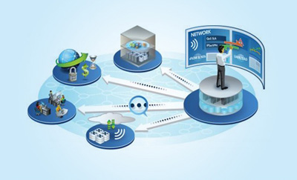
Problem description
Monitoring all flows in the network:
High computational cost
Traffic overhead
Impractical
Partial monitoring and PREDICTION
SDN architecture opens new approaches in comprehensive network monitoring and management.

Slide 10
AGENDA
Introduction
Related works
Problem description
Proposed approach
Evaluation
Conclusion and future work

Slide 11
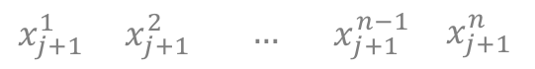
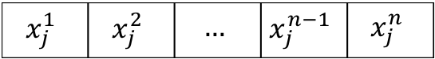
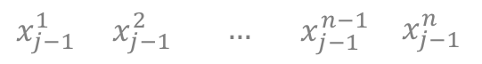
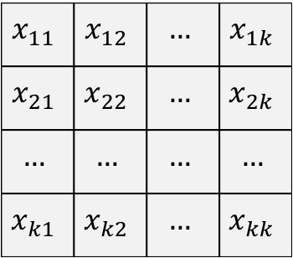
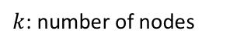
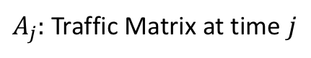
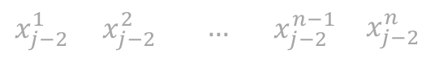
Problem description
$$x_{j−2}^{1}$$ | $$x_{j−2}^{2}$$ | $$…$$ | $$x_{j−2}^{n−1}$$ | $$x_{j−2}^{n}$$
$$x_{11}$$ | $$x_{12}$$ | $$…$$ | $$x_{1k}$$
$$x_{21}$$ | $$x_{22}$$ | $$…$$ | $$x_{2k}$$
$$…$$ | $$…$$ | $$…$$ | $$…$$
$$x_{k1}$$ | $$x_{k2}$$ | $$…$$ | $$x_{kk}$$
$$x_{j−1}^{1}$$ | $$x_{j−1}^{2}$$ | $$…$$ | $$x_{j−1}^{n−1}$$ | $$x_{j−1}^{n}$$
Flattening
$$x_{j}^{1}$$ | $$x_{j}^{2}$$ | $$…$$ | $$x_{j}^{n−1}$$ | $$x_{j}^{n}$$
$$x_{j+1}^{1}$$ | $$x_{j+1}^{2}$$ | $$…$$ | $$x_{j+1}^{n−1}$$ | $$x_{j+1}^{n}$$
$A_{j}:$Traffic Matrix at time $j$
Traffic Vector
$k$: number of nodes
$n=k^{2}$: number of original-destination pairs (OD pairs)

Slide 12

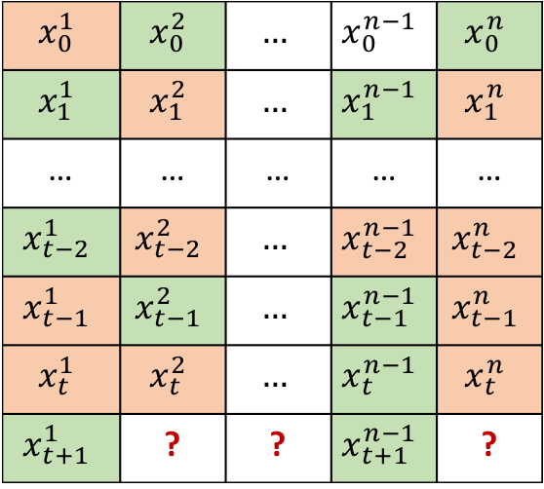
Problem description
Origin-Destination pairs flows
$$x_{0}^{1}$$ | $$x_{0}^{2}$$ | $$…$$ | $$x_{0}^{n−1}$$ | $$x_{0}^{n}$$
$$x_{1}^{1}$$ | $$x_{1}^{2}$$ | $$…$$ | $$x_{1}^{n−1}$$ | $$x_{1}^{n}$$
… | … | … | … | …
$$x_{t−2}^{1}$$ | $$x_{t−2}^{2}$$ | $$…$$ | $$x_{t−2}^{n−1}$$ | $$x_{t−2}^{n}$$
$$x_{t−1}^{1}$$ | $$x_{t−1}^{2}$$ | $$…$$ | $$x_{t−1}^{n−1}$$ | $$x_{t−1}^{n}$$
$$x_{t}^{1}$$ | $$x_{t}^{2}$$ | $$…$$ | $$x_{t}^{n−1}$$ | $$x_{t}^{n}$$
$$x_{t+1}^{1}$$ | ? | ? | $$x_{t+1}^{n−1}$$ | ?
Timestep
Prediction model
Time frame
 | Predicted data
 | Measured data

Slide 13
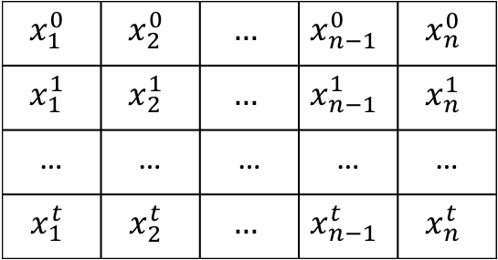
Problem description
Original-Destination pairs
$$x_{1}^{0}$$ | $$x_{2}^{0}$$ | $$…$$ | $$x_{n−1}^{0}$$ | $$x_{n}^{0}$$
$$x_{1}^{1}$$ | $$x_{2}^{1}$$ | $$…$$ | $$x_{n−1}^{1}$$ | $$x_{n}^{1}$$
… | … | … | … | …
$$x_{1}^{t}$$ | $$x_{2}^{t}$$ | $$…$$ | $$x_{n−1}^{t}$$ | $$x_{n}^{t}$$
Time
Current time step

Slide 14
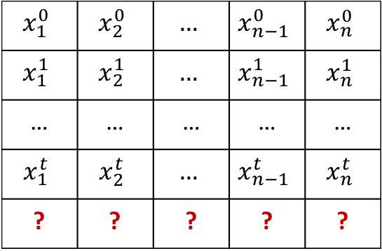
Problem description
Original-Destination pairs
$$x_{1}^{0}$$ | $$x_{2}^{0}$$ | $$…$$ | $$x_{n−1}^{0}$$ | $$x_{n}^{0}$$
$$x_{1}^{1}$$ | $$x_{2}^{1}$$ | $$…$$ | $$x_{n−1}^{1}$$ | $$x_{n}^{1}$$
… | … | … | … | …
$$x_{1}^{t}$$ | $$x_{2}^{t}$$ | $$…$$ | $$x_{n−1}^{t}$$ | $$x_{n}^{t}$$
? | ? | ? | ? | ?
Time
Current time step
Measurement all the flows are impractical!

Slide 15
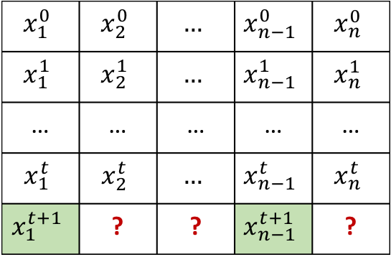
Problem description
Original-Destination pairs
$$x_{1}^{0}$$ | $$x_{2}^{0}$$ | $$…$$ | $$x_{n−1}^{0}$$ | $$x_{n}^{0}$$
$$x_{1}^{1}$$ | $$x_{2}^{1}$$ | $$…$$ | $$x_{n−1}^{1}$$ | $$x_{n}^{1}$$
… | … | … | … | …
$$x_{1}^{t}$$ | $$x_{2}^{t}$$ | $$…$$ | $$x_{n−1}^{t}$$ | $$x_{n}^{t}$$
$$x_{1}^{t+1}$$ | ? | ? | $$x_{n−1}^{t+1}$$ | ?
Time

Slide 16
Problem description
Original-Destination pairs
$$x_{1}^{0}$$ | $$x_{2}^{0}$$ | $$…$$ | $$x_{n−1}^{0}$$ | $$x_{n}^{0}$$
$$x_{1}^{1}$$ | $$x_{2}^{1}$$ | $$…$$ | $$x_{n−1}^{1}$$ | $$x_{n}^{1}$$
… | … | … | … | …
$$x_{1}^{t}$$ | $$x_{2}^{t}$$ | $$…$$ | $$x_{n−1}^{t}$$ | $$x_{n}^{t}$$
$$x_{1}^{t+1}$$ | ? | ? | $$x_{n−1}^{t+1}$$ | ?
Time
Prediction model

Slide 17
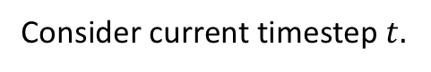
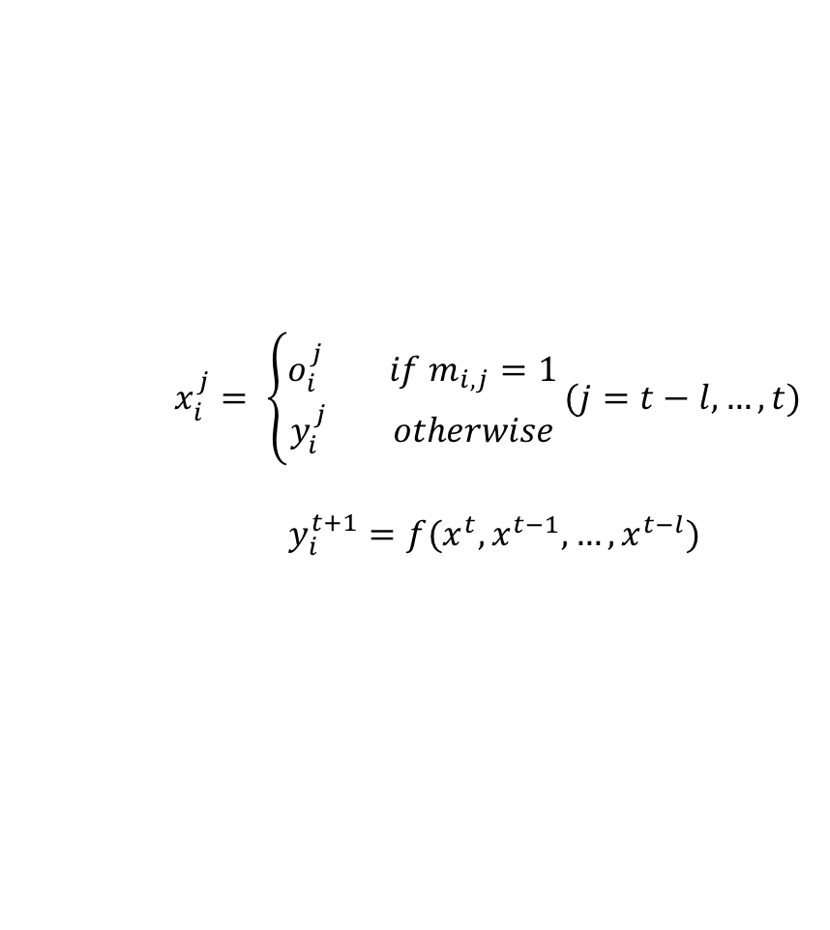
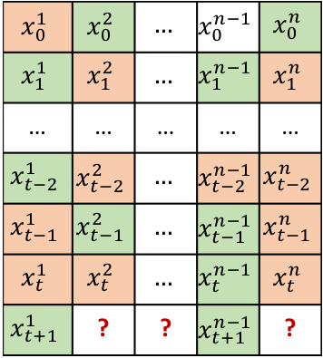
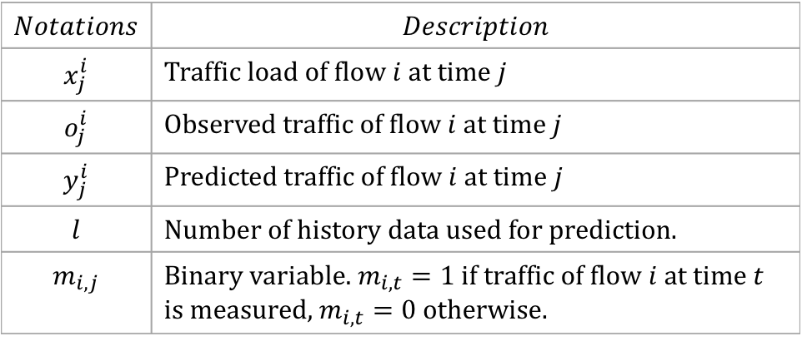
Semi-recursive prediction
Consider current timestep $t.$
Origin-Destination flows
$$x_{0}^{1}$$ | $$x_{0}^{2}$$ | $$…$$ | $$x_{0}^{n−1}$$ | $$x_{0}^{n}$$
$$x_{1}^{1}$$ | $$x_{1}^{2}$$ | $$…$$ | $$x_{1}^{n−1}$$ | $$x_{1}^{n}$$
… | … | … | … | …
$$x_{t−2}^{1}$$ | $$x_{t−2}^{2}$$ | $$…$$ | $$x_{t−2}^{n−1}$$ | $$x_{t−2}^{n}$$
$$x_{t−1}^{1}$$ | $$x_{t−1}^{2}$$ | $$…$$ | $$x_{t−1}^{n−1}$$ | $$x_{t−1}^{n}$$
$$x_{t}^{1}$$ | $$x_{t}^{2}$$ | $$…$$ | $$x_{t}^{n−1}$$ | $$x_{t}^{n}$$
$$x_{t+1}^{1}$$ | ? | ? | $$x_{t+1}^{n−1}$$ | ?
$x_{i}^{j}= \left\{\begin{aligned}o_{i}^{j} if m_{i,j}=1 \\ y_{i}^{j} otherwise\end{aligned}\right.(j=t−l,…,t)$
$$y_{i}^{t+1}=f(x^{t}, x^{t−1}, …, x^{t−l})$$
$$Notations$$ | $$Description$$
$$x_{j}^{i}$$ | Traffic load of flow $i$ at time $j$
$$o_{j}^{i}$$ | Observed traffic of flow $i$ at time $j$
$$y_{j}^{i}$$ | Predicted traffic of flow $i$ at time $j$
$$l$$ | Number of history data used for prediction.
$$m_{i,j}$$ | Binary variable. $m_{i,t}=1$ if traffic of flow $i$ at time $t$ is measured, $m_{i,t}=0$ otherwise.
 | Predicted data
 | Measured data

Slide 18
Challenges and Goals
Accumulative error
Direct Prediction
Semi-recursive Prediction
Alleviating the accumulate errors
Correcting the imprecise input data

Slide 19
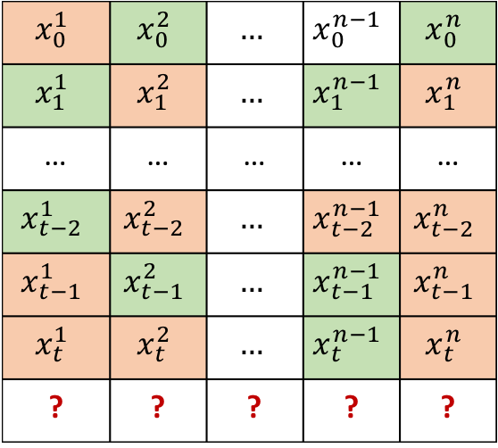
Challenges and Goals
Determining the monitored flow set
$$x_{0}^{1}$$ | $$x_{0}^{2}$$ | $$…$$ | $$x_{0}^{n−1}$$ | $$x_{0}^{n}$$
$$x_{1}^{1}$$ | $$x_{1}^{2}$$ | $$…$$ | $$x_{1}^{n−1}$$ | $$x_{1}^{n}$$
… | … | … | … | …
$$x_{t−2}^{1}$$ | $$x_{t−2}^{2}$$ | $$…$$ | $$x_{t−2}^{n−1}$$ | $$x_{t−2}^{n}$$
$$x_{t−1}^{1}$$ | $$x_{t−1}^{2}$$ | $$…$$ | $$x_{t−1}^{n−1}$$ | $$x_{t−1}^{n}$$
$$x_{t}^{1}$$ | $$x_{t}^{2}$$ | $$…$$ | $$x_{t}^{n−1}$$ | $$x_{t}^{n}$$
? | ? | ? | ? | ?
Designing a scheme for selecting which flow will be monitored in the next timestep.

Slide 20
AGENDA
Introduction
Related works
Problem description
Proposed approach
Evaluation
Conclusion and future work

Slide 21
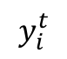
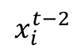
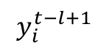
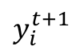
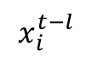
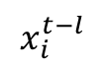
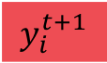
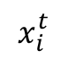
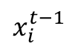
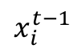
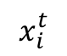
Traffic prediction using Recurrent Neural Network
$$x_{i}^{t−l}$$
…
$$x_{i}^{t−2}$$
$$x_{i}^{t−1}$$
$$x_{i}^{t}$$
$$y_{i}^{t+1}$$
$$y_{i}^{t−l+1}$$
…
$$y_{i}^{t}$$
$$y_{i}^{t+1}$$
LSTM
…
LSTM
LSTM
…
$$x_{i}^{t−l}$$
$$x_{i}^{t−1}$$
$$x_{i}^{t}$$

Slide 22
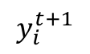
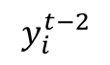
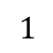
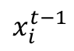
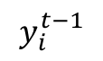
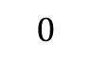
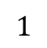
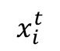
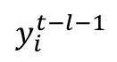
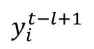
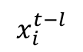
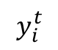
Forward and backward networks
$$x_{i}^{t−l}$$
…
$$x_{i}^{t−2}$$
$$x_{i}^{t−1}$$
$$x_{i}^{t}$$
$$y_{i}^{t+1}$$
$$y_{i}^{t−l−1}$$
…
$$y_{i}^{t−2}$$
$$y_{i}^{t−1}$$
$$y_{i}^{t−l+1}$$
…
$$y_{i}^{t}$$
$$y_{i}^{t+1}$$
LSTM
…
LSTM
LSTM
LSTM
…
LSTM
LSTM
$$x_{i}^{t−l}$$
$$1$$
…
$$x_{i}^{t−1}$$
$$0$$
$$x_{i}^{t}$$
$$1$$

Slide 23
Traffic matrix estimation – A route map
Infocom [1]
SDN-related
Compressed Sensing
Infocom [3]
SDN-related
Compressed Sensing
Combine the Aggregated flows and Link Count
Infocom [5]
SDN-related
Sampling approach
Infocom 2017 [8]
Tensor completion
2014
2015
2016
2017
ICDCS [2]
SDN-related
Infocom [4]
Matrix Completion
Sampling Approach
Infocom [6]
Tensor-completion
Journals: [7]
Traffic Matrix estimation based on deep learning and probabilistic model

Slide 24
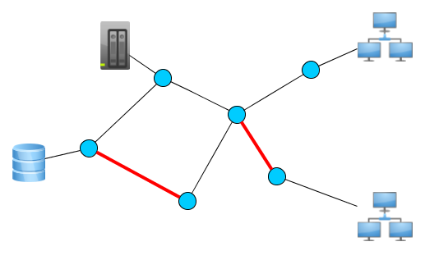
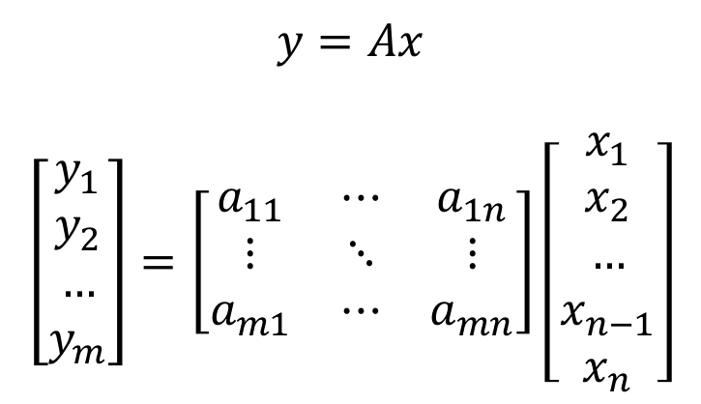
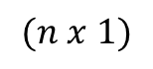
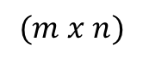

Traffic Matrix estimation: From network tomography to matrix completion problems
$$y=Ax$$
$$\left[\begin{aligned}y_{1} \\ y_{2} \\ … \\ y_{m}\end{aligned}\right]=\left[\begin{matrix}a_{11} & ⋯ & a_{1n} \\ ⋮ & ⋱ & ⋮ \\ a_{m1} & ⋯ & a_{mn}\end{matrix}\right]\left[\begin{aligned}x_{1} \\ x_{2} \\ … \\ x_{n−1} \\ x_{n}\end{aligned}\right]$$
$$(m x 1)$$
$$(m x n)$$
$$(n x 1)$$
Link count
Routing matrix
Vector of traffic
measured
Vector of flows

Slide 25












Time Series Prediction strategies
Direct prediction
Recursive prediction
$$y_{t}=f(x_{t−1, } x_{t−2}, …, x_{t−m })$$
$$y_{t}=f(x_{t−1, } x_{t−2}, …, x_{t−m })$$
$$y_{t+1}=f(x_{t, } x_{t−1}, …, x_{t−m+1 })$$
$$y_{t+1}=f(y_{t, } x_{t−1}, …, x_{t−m+1 })$$
$$x_{t−m}$$ | … | $$x_{t−2}$$ | $$x_{t−1}$$
$$y_{t}$$
$$x_{t−m}$$ | … | $$x_{t−2}$$ | $$x_{t−1}$$
$$y_{t}$$
$$x_{t−m+1}$$ | … | $$x_{t−1}$$ | $$x_{t}$$
$$y_{t+1}$$
$$x_{t−m+1}$$ | … | $$x_{t−1}$$ | $$y_{t}$$
$$y_{t+1}$$

Slide 26



Direct Prediction
$$y_{t}=f(x_{t−1, } x_{t−2}, …, x_{t−m })$$
$$y_{t+1}=f(x_{t, } x_{t−1}, …, x_{t−m+1 })$$
Temperature Prediction
Total sales estimation
Downlink and Uplink traffic prediction in cellular network [INFOCOM17]

Slide 27


Direct and recursive prediction in backbone traffic
Direct prediction
Recursive prediction
(with 30% of correct data)

Slide 28

Semi-recursive prediction problems in time series traffic matrix prediction.
$$Notations$$ | $$Description$$
$$x_{i}^{t}$$ | Traffic load of flow $i$ at time $t$
$$o_{i}^{t}$$ | Observed traffic of flow $i$ at time $t$
$$y_{i}^{t}$$ | Predicted traffic of flow $i$ at time $t$
$$l$$ | Number of history data used for prediction.
$$m_{i,t}$$ | Binary variable. $m_{i,t}=1$ if traffic of flow $i$ at time $t$ is measured, $m_{i,t}=0$ otherwise.

Slide 29


Semi-recursive prediction problems in time series traffic matrix prediction.
$$x_{i}^{t}= \left\{\begin{aligned}o_{i}^{t} if m_{i,t}=1 \\ y_{i}^{t} otherwise\end{aligned}\right.$$
$$y_{i}^{t+1}=f(x^{t}, x^{t−1}, …, x^{t−l})$$
A model $f(.)$ for temporal modeling and predicting future traffic load.
Correcting the predicted data before feeding it to the model.
Determining which flows need to be measured in the next time step.

Slide 30



Proposed Model – Recurrent Neural Network
Example with input length is 8
Recurrent Neural Network
$$x_{1}$$ | $$x_{2}$$ | $$x_{3}$$ | $$x_{4}$$ | $$x_{5}$$ | $$x_{6}$$ | $$x_{7}$$ | $$x_{8}$$
$$y_{9}$$
$$x_{i}$$ | Predicted input
$$x_{j}$$ | Measured input
$$y_{i}$$ | Predicted output

Slide 31



















Proposed Model – Forward RNN
$$x_{i}$$ | Predicted input
$$x_{j}$$ | Measured input
$$y_{i}$$ | Output of forward RNN
Recurrent Neural Network
$$x_{1}$$ | $$x_{2}$$ | $$x_{3}$$ | $$x_{4}$$ | $$x_{5}$$ | $$x_{6}$$ | $$x_{7}$$ | $$x_{8}$$
$$y_{9}$$
$$y_{2}$$
$$y_{3}$$
$$y_{4}$$
$$y_{5}$$
$$y_{6}$$
$$y_{7}$$
$$y_{8}$$
$$y_{9}$$
$$x_{1}$$
$$x_{2}$$
$$x_{3}$$
$$x_{4}$$
$$x_{5}$$
$$x_{6}$$
$$x_{7}$$
$$x_{8}$$

Slide 32






Proposed Model – Forward RNN
$$x_{i}$$ | Predicted input
$$x_{j}$$ | Measured input
$$y_{i}$$ | Output of forward RNN
Recurrent Neural Network
$$x_{1}$$ | $$x_{2}$$ | $$x_{3}$$ | $$x_{4}$$ | $$x_{5}$$ | $$x_{6}$$ | $$x_{7}$$ | $$x_{8}$$
$$y_{9}$$
$$y_{2}$$
$$y_{3}$$
$$y_{4}$$
$$y_{5}$$
$$y_{6}$$
$$y_{7}$$
$$y_{8}$$
$$y_{9}$$
$$x_{1}$$
$$1$$
$$x_{2}$$
$$0$$
$$x_{3}$$
$$0$$
$$x_{4}$$
$$1$$
$$x_{5}$$
$$0$$
$$x_{6}$$
$$1$$
$$x_{7}$$
$$1$$
$$x_{8}$$
$$0$$

Slide 33

















Proposed Model – Backward RNN
$$x_{i}$$ | Predicted input
$$x_{j}$$ | Measured input
$$y_{i}^{′}$$ | Output of backward RNN
Recurrent Neural Network
$$x_{8}$$ | $$x_{7}$$ | $$x_{6}$$ | $$x_{5}$$ | $$x_{4}$$ | $$x_{3}$$ | $$x_{2}$$ | $$x_{1}$$
$$y_{0}$$
$$y_{0}^{′}$$
$$y_{1}^{′}$$
$$y_{2}^{′}$$
$$y_{3}^{′}$$
$$y_{4}^{′}$$
$$y_{5}^{′}$$
$$y_{6}^{′}$$
$$y_{7}^{′}$$
$$x_{1}$$
$$1$$
$$x_{2}$$
$$0$$
$$x_{3}$$
$$0$$
$$x_{4}$$
$$1$$
$$x_{5}$$
$$0$$
$$x_{6}$$
$$1$$
$$x_{7}$$
$$1$$
$$x_{8}$$
$$0$$

Slide 34































Proposed Model – Bidirectional RNN
$$x_{i}$$ | Predicted input
$$x_{j}$$ | Measured input
$$y_{i}$$ | Output of forward RNN
$$y_{i}^{′}$$ | Output of backward RNN
 | Forward RNN unit
 | Backward RNN unit
$$y_{2}$$
$$y_{0}^{′}$$
$$y_{3}$$
$$y_{1}^{′}$$
$$y_{4}$$
$$y_{2}^{′}$$
$$y_{5}$$
$$y_{3}^{′}$$
$$y_{6}$$
$$y_{4}^{′}$$
$$y_{7}$$
$$y_{5}^{′}$$
$$y_{8}$$
$$y_{6}^{′}$$
$$y_{9}$$
$$y_{7}^{′}$$
$$x_{1}$$
$$1$$
$$x_{2}$$
$$0$$
$$x_{3}$$
$$0$$
$$x_{4}$$
$$1$$
$$x_{5}$$
$$0$$
$$x_{6}$$
$$1$$
$$x_{7}$$
$$1$$
$$x_{8}$$
$$0$$

Slide 35

















Correcting RNN input
$$x_{j}^{i}$$ | Predicted input
$$x_{j}^{i}$$ | Measured input
$$y_{j}^{i}$$ | Output of forward RNN
$$y_{j}^{′i}$$ | Output of backward RNN
 | Forward RNN unit
 | Backward RNN unit
$$y_{3}^{i}$$
$$y_{3}^{′i}$$
$$x_{1}^{i}$$
$$1$$
$$x_{2}^{i}$$
$$0$$
$$x_{3}^{i}$$
$$0$$
$$x_{4}^{i}$$
$$0$$
$$x_{5}^{i}$$
$$0$$
$$x_{6}^{i}$$
$$1$$
$$x_{7 }^{i}$$
$$1$$
$$x_{8}^{i}$$
$$0$$

Slide 36






Confidence factors
$$y_{j}^{i}$$
$$y_{j}^{′i}$$
g$(.)$
$$x_{j}^{i}$$
$$x_{j}^{i}$$
$$\left\{\begin{aligned}\text{g}\left(x_{i}, y_{i}, y_{i}^{′}\right)=α∗x_{j}^{i}+β∗y_{j}^{i}+γ∗y_{j}^{′i} \\ \left(α+β+γ=1\right)\end{aligned} j=\left(t−l, …,t\right);m_{i,j} =0\right.$$

Slide 37




















Forward loss and backward loss
$$y_{2}^{i}$$
$$y_{3}^{i}$$
$$y_{4}^{i}$$
$$y_{5}^{i}$$
$$y_{6}^{i}$$
$$y_{7}^{i}$$
$$y_{8}^{i}$$
$$y_{9}^{i}$$
$$x_{1}^{i}$$
$$1$$
$$x_{2}^{i}$$
$$0$$
$$x_{3}^{i}$$
$$0$$
$$x_{4}^{i}$$
$$1$$
$$x_{5}^{i}$$
$$0$$
$$x_{6}^{i}$$
$$1$$
$$x_{7}^{i}$$
$$1$$
$$x_{8}^{i}$$
$$0$$
$$l_{t,i}^{f}=\left\{\begin{aligned}+∞ if \sum_{j=t−l}^{t}{m_{i,j}=0} \\ \sqrt{\sum_{j=t−l}^{t}{m_{i,j}∗{\left(y_{j}^{i} −x_{j}^{i}\right)}^{2}}} otherwise\end{aligned}\right.$$

Slide 38




















Forward loss and backward loss
$$y_{0}^{′i}$$
$$y_{1}^{′i}$$
$$y_{2}^{′i}$$
$$y_{3}^{′i}$$
$$y_{4}^{′i}$$
$$y_{5}^{′i}$$
$$y_{6}^{′i}$$
$$y_{7}^{′i}$$
$$x_{1}^{i}$$
$$1$$
$$x_{2}^{i}$$
$$0$$
$$x_{3}^{i}$$
$$0$$
$$x_{4}^{i}$$
$$1$$
$$x_{5}^{i}$$
$$0$$
$$x_{6}^{i}$$
$$1$$
$$x_{7}^{i}$$
$$1$$
$$x_{8}^{i}$$
$$0$$
$$l_{t,i}^{b}=\left\{\begin{aligned}+∞ if \sum_{j=t−l}^{t}{m_{i}^{j}=0} \\ \sqrt{\sum_{j=t−l}^{t}{m_{i}^{j}{\left(y_{i}^{′j} −x_{i}^{j}\right)}^{2}}} otherwise\end{aligned}\right.$$

Slide 39

Correcting RNN input
$$\text{g}\left(x_{i}, y_{i}, y_{i}^{′}\right)=α∗x_{i}^{j}+β∗y_{i}^{j}+γ∗y_{i}^{′j} \left(α+β+γ=1\right)$$
Where:
$$α=1−η_{t}^{i};$$
$$β=\frac{l_{i,t}^{b}\left(1−α\right)}{{l_{i,t}}^{f}+l_{i,t}^{b}};$$
$$γ= \frac{l_{i,t}^{f}\left(1−α\right)}{l_{i,t}^{f}+l_{i,t}^{b}}$$
$η_{t}^{i}=\left\{\begin{aligned}\frac{\sum_{j}{m_{i,j}}}{l} \\ ε\end{aligned} \begin{aligned}if \sum_{j}{m_{i,j}}>0 \\ otherwise\end{aligned} (j=t−l,…,t)\right.$

Slide 40

Determining monitored flows
Original-Destination pairs
$$x_{1}^{0}$$ | $$x_{2}^{0}$$ | $$…$$ | $$x_{n−1}^{0}$$ | $$x_{n}^{0}$$
$$x_{1}^{1}$$ | $$x_{2}^{1}$$ | $$…$$ | $$x_{n−1}^{1}$$ | $$x_{n}^{1}$$
… | … | … | … | …
$$x_{1}^{t−2}$$ | $$x_{2}^{t−2}$$ | $$…$$ | $$x_{n−1}^{t−2}$$ | $$x_{n}^{t−2}$$
$$x_{1}^{t−1}$$ | $$x_{2}^{t−1}$$ | $$…$$ | $$x_{n−1}^{t−1}$$ | $$x_{n}^{t−1}$$
$$x_{1}^{t}$$ | $$x_{2}^{t}$$ | $$…$$ | $$x_{n−1}^{t}$$ | $$x_{n}^{t}$$
$$x_{1}^{t+1}$$ | ? | ? | $$x_{n−1}^{t+1}$$ | ?
Time
Current time step
Next time step
 | Predicted data
 | Measured data
Random
Strategies

Slide 41



Consecutive loss
Original-Destination pairs
$$x_{0}^{1}$$ | $$x_{0}^{2}$$ | $$…$$ | $$x_{0}^{n−1}$$ | $$x_{0}^{n}$$
$$x_{1}^{1}$$ | $$x_{1}^{2}$$ | $$…$$ | $$x_{1}^{n−1}$$ | $$x_{1}^{n}$$
… | … | … | … | …
$$x_{t−2}^{1}$$ | $$x_{t−2}^{2}$$ | $$…$$ | $$x_{t−2}^{n−1}$$ | $$x_{t−2}^{n}$$
$$x_{t−1}^{1}$$ | $$x_{t−1}^{2}$$ | $$…$$ | $$x_{t−1}^{n−1}$$ | $$x_{t−1}^{n}$$
$$x_{t}^{1}$$ | $$x_{t}^{2}$$ | $$…$$ | $$x_{t}^{n−1}$$ | $$x_{t}^{n}$$
? | ? | ? | ? | ?
$l_{i,t}^{c}$: indicates how long $OD_{i}$ has not been monitored
the number of timesteps from when $OD_{i}$ was last monitored till the current timestep $t$
Time
e.g:
$$l_{1,t}^{c}=2$$
$$l_{2,t}^{c}=1$$
$$l_{n,t}^{c}=3$$
 | Predicted data
 | Measured data

Slide 42


Detrended Fluctuation Analysis - DFA
Analysis technique studies the fluctuations in time series, specifically to address non-stationaries.
Given a time series process $x_{t}, t∈N.$
$x$ is shifted by the mean $\left\langle x\right\rangle$ and integrated $y\left(k\right)= \sum_{i=1}^{k}{(x_{i}−\left\langle x\right\rangle )}$ then segmented into windows of various size $Δn.$
In each segmentation, the data is locally fit to a polynomial $y_{Δn}(k)$ and the mean squared residual is found (”the fluctuations”):
$$F\left(Δn\right)= \sqrt{\frac{1}{N}\sum_{k}^{N}{{\left[y\left(k\right)−y_{Δn}\left(k\right)\right]}^{2}}}$$

Slide 43


Determining monitored flows
For each $OD_{i}$, we calculate a “weight” $w_{i}$ following the equation () and then choosing the lowest $k$ flows to measure in the next time step.
$$w_{t}^{i}= \frac{1}{l_{i,t}^{f}+l_{i,t}^{b}+l_{i,t}^{c}+s_{i,t}} ()$$
Where:
$w_{t}^{i}: the weight of flow i at timestep t$
$l_{i,t}^{f} the forward loss of the flow i at timestep t$
$l_{i,t}^{b}: the backward loss of the flow i at timestep t$
$l_{i,t}^{c}: the consecutive loss of the flow OD_{i}$
$s_{i,t}: the standard deviation of the flow OD_{i} in the time frame$

Slide 44
AGENDA
Introduction
Related works
Problem description
Proposed approach
Evaluation
Conclusion and future work

Slide 45

Abilene dataset
Measurement period: from 2004-03-01 to 2004-09-10
168 days
Measurement interval: 5 minutes
288 timestamps per day
Number of nodes: 12
Number of OD flows: 144
Number of traffic data: 288*168*144 = 6967296

Slide 46
Experiment setup
Hardware
CPU | Intel(R) Core(TM) i7-6800K CPU@3.40GGHz
GPU | GeForce GTX 1080Ti
RAM | 32G
RNN – Configuration
Hidden units | 100
Layers | 1
Dropout | 0.2
Training Epoch | 100

Slide 47





Metrics
Error ratio
Mean absolute errors
Root mean squared errors
$$E_{r}= \frac{\sqrt{\sum_{i,j}{{\left(o_{j}^{i} −x_{j}^{i}\right)}^{2}}}}{\sqrt{\sum_{i,t}{{\left(o_{j}^{i}\right)}^{2}}}} ∀ m_{i,j}=0$$
$$MAE= \frac{1}{N}\sum_{i.j}{\left|o_{j}^{i}−x_{j}^{i}\right|}$$
$$RMSE=\sqrt{\frac{1}{N}\sum_{i,j}{{\left(o_{j}^{i} −x_{j}^{i} \right)}^{2}}}$$
$$j=0,…,N$$
$N$ is the size of the testing set
Notes:
MAE: average absolute errors
RMSE: presents sample standard deviation of the differences between

Slide 48
Flow prediction result
TRAFFIC PREDICTION OF A RANDOM FLOW

Slide 49
Performance comparison
48.3%
32.7%
62.9%

Slide 50
Consecutive loss
Data of 4 hours (from 10a.m every day) are all loss

Slide 51
BiRNN configuration
Number of hidden units: 300
Number of layer: 1
Number of epoch: 124

Slide 52





Network Tomography in SDN
$$y=Ax$$
$$(m x 1)$$
$$(m x n)$$
$$(n x 1)$$
$$m≪n$$
Aggregated Flow Statistics
In large-scale network, real-time monitoring of traffic is intractable

Slide 53
Many-to-one RNN
Prediction with corrected input
Prediction with sampling traffics at 20%

Slide 54

Matrix completion
Matrix recovery (INFOCOM2015) [4]

Slide 55


The spatial-temporal feature of traffic
Empirical study with real traffic data. [6]
$$Δday\left(i,j,k\right)= \frac{\left|z(i,j,k) −z(i,j,k+288)\right|}{\max_{1≤k≤Γ−288}\left|z(i,j,k) −z(i,j,k+288)\right|}$$

Slide 56


Tensor completion
3-way tensor completion (Infocom2016-2017) [6]

Slide 57


Deep learning Approach
Deep RBM architecture for matrix prediction [7]

Slide 58




SDN and Traffic Matrix estimation
$$Y= \left[\begin{aligned}Y_{g} \\ Y_{k}\end{aligned}\right]=\left[\begin{aligned}A_{g} \\ A_{k}\end{aligned}\right]X$$
$Y_{g}:$ aggregated measurement
$Y_{k}:$ directed per-flow measurement
$A_{g}:$ represents the set of aggregated flow
$$Y= \left[\begin{aligned}y_{1} \\ y_{2} \\ y_{3} \\ y_{4}\end{aligned}\right]=\left[\begin{aligned}x_{1}+x_{2} \\ x_{4}+x_{6} \\ x_{3} \\ x_{5}\end{aligned}\right]=\left[\begin{aligned}A_{g} \\ A_{k}\end{aligned}\right]X=\left[\begin{aligned}\left[\begin{aligned}1 \\ 0\end{aligned}\begin{aligned}1 \\ 0\end{aligned}\begin{aligned}0 \\ 0\end{aligned}\begin{aligned}0 \\ 1\end{aligned}\begin{aligned}0 \\ 0\end{aligned}\begin{aligned}0 \\ 1\end{aligned}\right] \\ \left[\begin{aligned}0 \\ 0\end{aligned}\begin{aligned}0 \\ 0\end{aligned}\begin{aligned}1 \\ 0\end{aligned}\begin{aligned}0 \\ 0\end{aligned}\begin{aligned}0 \\ 1\end{aligned}\begin{aligned}0 \\ 0\end{aligned}\right]\end{aligned}\right]\left[\begin{aligned}x_{1} \\ x_{2} \\ x_{3} \\ x_{4} \\ x_{5} \\ x_{6}\end{aligned}\right]$$
Apply Compressed Sensing for optimal design the flow aggregated matrix (matrix A) to get higher accuracy

Slide 59


SDN and Traffic Matrix estimation
Results depend on how traffic are routed in the network.
The higher number of per-flow measurements, the higher accuracy.
$K:$ number of per-flow measurements
$T:$ total number of flow entries
$n:$ total number of flows in the network

Slide 60

RNN and Traffic Matrix inference
Unroll RNN model

Slide 61





Many-to-one RNN model
$$x_{w+1}$$
LSTM
LSTM
LSTM
…
$$x_{1}$$
$$x_{2}$$
$$x_{w}$$

Slide 62


Autocorrelation function
$$ρ\left(h\right)= \frac{\sum_{t=1}^{T−\left|h\right|}{(z_{t+\left|h\right|}−\overline{z})(z_{t}−\overline{z})}}{\sum_{t=1}^{T}{{\left(z_{t}−\overline{z}\right)}^{2}}}$$

Slide 63


Autocorrelation function
$$ρ\left(h\right)= \frac{\sum_{t=1}^{T−\left|h\right|}{(z_{t+\left|h\right|}−\overline{z})(z_{t}−\overline{z})}}{\sum_{t=1}^{T}{{\left(z_{t}−\overline{z}\right)}^{2}}}$$

Slide 64

Autocorrelation function

Slide 65


Consecutive loss
Prediction with sampling traffics at 20%
Prediction with sampling traffics at 30%

Slide 66








Bidirectional RNN.
He said: ‘’Teddy bears are on sale!”
He said: “Teddy Roosevelt was great President!”
$$y_{1}$$
$$y_{2}$$
$$…$$
$$y_{n}$$
$$x_{1}$$
$$x_{2}$$
$$…$$
$$x_{n}$$

Slide 67











Bidirectional RNN.
$$x_{1}$$ | $$x_{2}$$ | $$x_{3}$$ | $$x_{4}$$ | $$x_{5}$$ | $$x_{6}$$ | $$x_{7}$$ | $$x_{8}$$
$$y_{2}$$
$$y_{4}^{′}$$
$$x_{1}$$
$$x_{2}$$
$$x_{3}$$
$$x_{4}$$
$$x_{5}$$
$$x_{6}$$
$$x_{7}$$
$$x_{8}$$

Slide 68



















Bidirectional RNN with attention.
$$y_{1}$$
$$y_{2}$$
$$y_{3}$$
$$y_{4}$$
$$y_{5}$$
$$y_{6}$$
$$y_{7}$$
$$y_{8}$$
$$α^{(1,1)}$$
$$α^{(1,2)}$$
$$α^{(1,8)}$$
$$x_{1}$$
$$x_{2}$$
$$x_{3}$$
$$x_{4}$$
$$x_{5}$$
$$x_{6}$$
$$x_{7}$$
$$x_{8}$$

Slide 69

The proposed model
LSTM
LSTM
LSTM
Attention
Attention
Attention
Spatial-Temporal Clustering
$$x_{1}$$ | $$x_{2}$$ | $$x_{3}$$ | $$x_{4}$$ | $$x_{5}$$ | $$x_{6}$$ | $$x_{7}$$ | $$x_{8}$$

Slide 70
References
[1] Malboubi, M., Wang, L., Chuah, C. N., & Sharma, P. (2014). Intelligent SDN based traffic (de)Aggregation and Measurement Paradigm (iSTAMP). Proceedings - IEEE INFOCOM, 934–942.
[2] Suh, Junho, et al. "Opensample: A low-latency, sampling-based measurement platform for commodity sdn." Distributed Computing Systems (ICDCS), 2014 IEEE 34th International Conference on. IEEE, 2014.
[3] Hu, Z., & Luo, J. (2015). Cracking network monitoring in DCNs with SDN. Proceedings - IEEE INFOCOM, 26, 199–207.
[4] Xie, K., Wang, L., Wang, X., Xie, G., Zhang, G., Xie, D., & Wen, J. (2015). Sequential and adaptive sampling for matrix completion in network monitoring systems. Computer Communications (INFOCOM), 2015 IEEE Conference on, 2443–2451.
[5] Bozakov, Zdravko, et al. "Measurement-based flow characterization in centrally controlled networks." Computer Communications, IEEE INFOCOM 2016-The 35th Annual IEEE International Conference on. IEEE, 2016.
[6] Xie, K., Wang, L., Wang, X., Xie, G., Wen, J., & Zhang, G. (2016). Accurate recovery of Internet traffic data: A tensor completion approach. Transaction on Networking, 2016–July, 1–14.
[7] Nie, L., Jiang, D., Guo, L., & Yu, S. (2016). Traffic matrix prediction and estimation based on deep learning in large-scale IP backbone networks. Journal of Network and Computer Applications, 76(October), 16–22.
[8] Xie, Kun, et al. "Accurate recovery of Internet traffic data under dynamic measurements." INFOCOM 2017-IEEE Conference on Computer Communications, IEEE. IEEE, 2017.

Slide 71
THANK YOU

